Slide 1

TEAM JACK-O’-LANTERNS
Michal Fineman, Bill Riggio, Christy Rose
USING ETL TO EVALUATE PET STORE WEBSITES

Slide 2
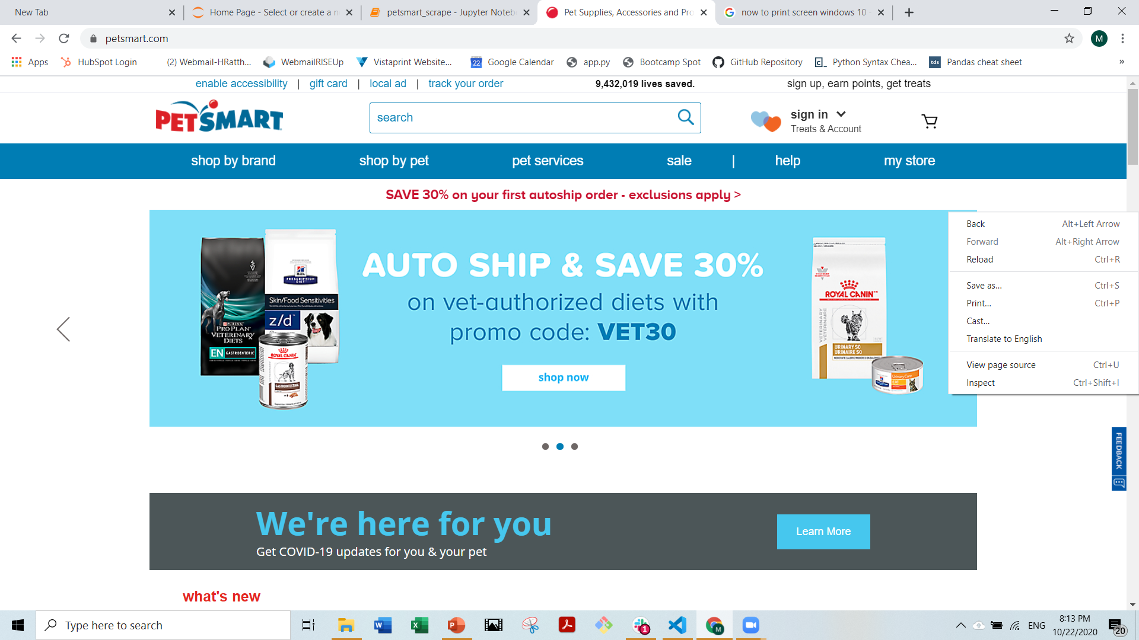
Notes:
Christy and I identified a couple of web sites that sell pet supplies and inspected the meta data—(which, as you can see here, you can access by right clicking and selecting “view page source”)—

Slide 3
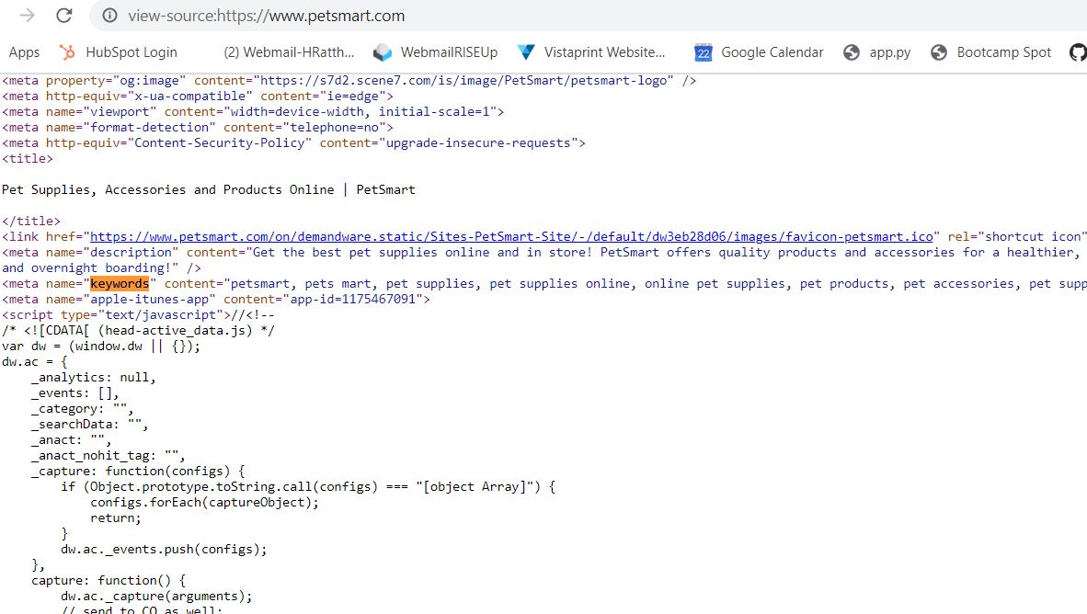
Notes:
Here’s what the source page looks like and you can see that petsmart identified a bunch of terms that they thought search engines would pick up on.

Slide 4
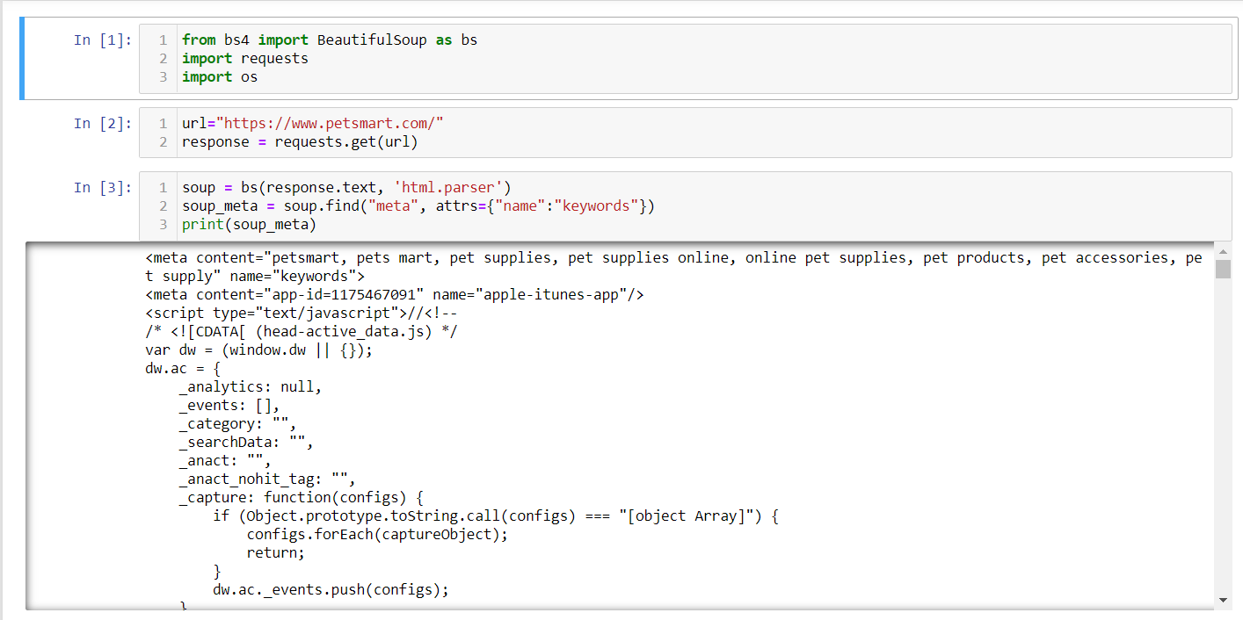
Notes:
Using requests and beautiful soup, I captured that meta data—I had to use the attributes code in the argument in order to reach the keywords. The result is this whole string of code. We’re looking for just this part in the “content” attribute.

Slide 5
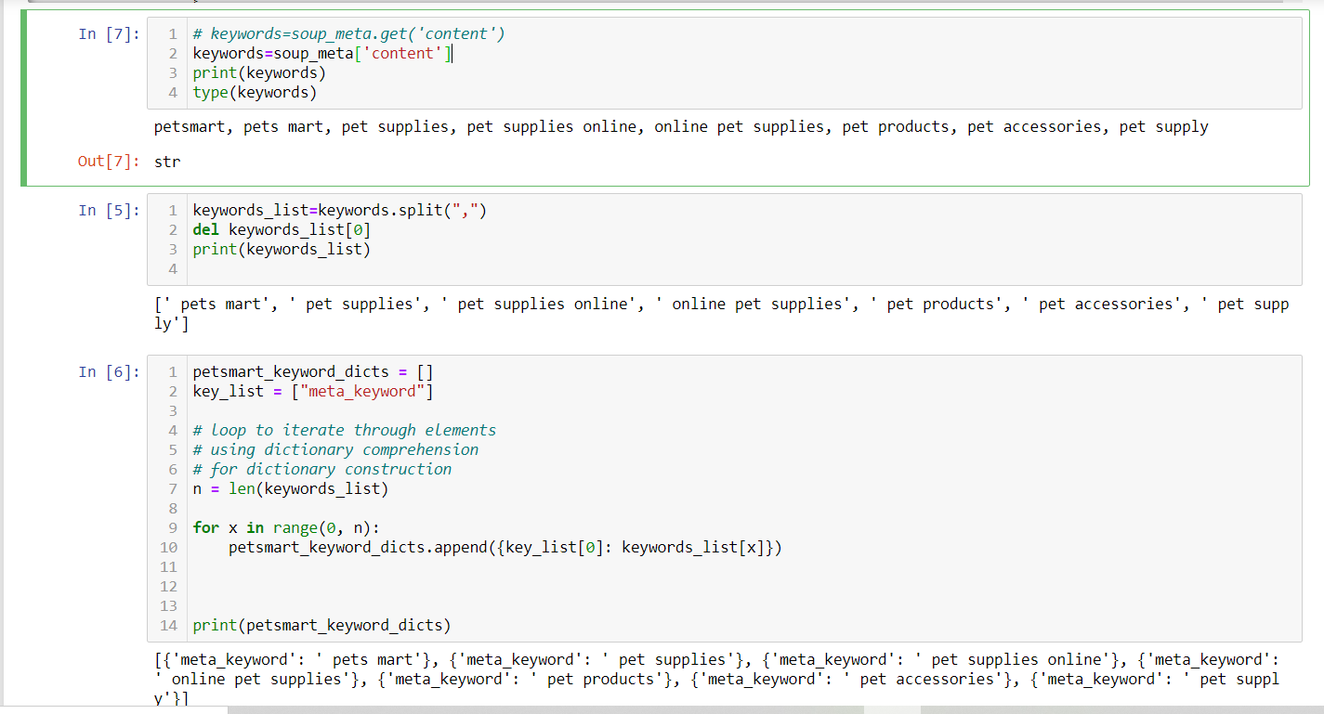
Notes:
So we call the content attribute and end up with a string. So in order for that to be useful, we have to split it into separate items based on the comma delimiter. Not a lot of cleaning was called for except to eliminate the keyword that was just the store’s name. What’s left gets stored in a list that Bill will use later.
The rest of this code is making a dictionary and uploading it to a Mongos db, but we don’t use that bit until later in the app Bill will show you in a minute.

Slide 6
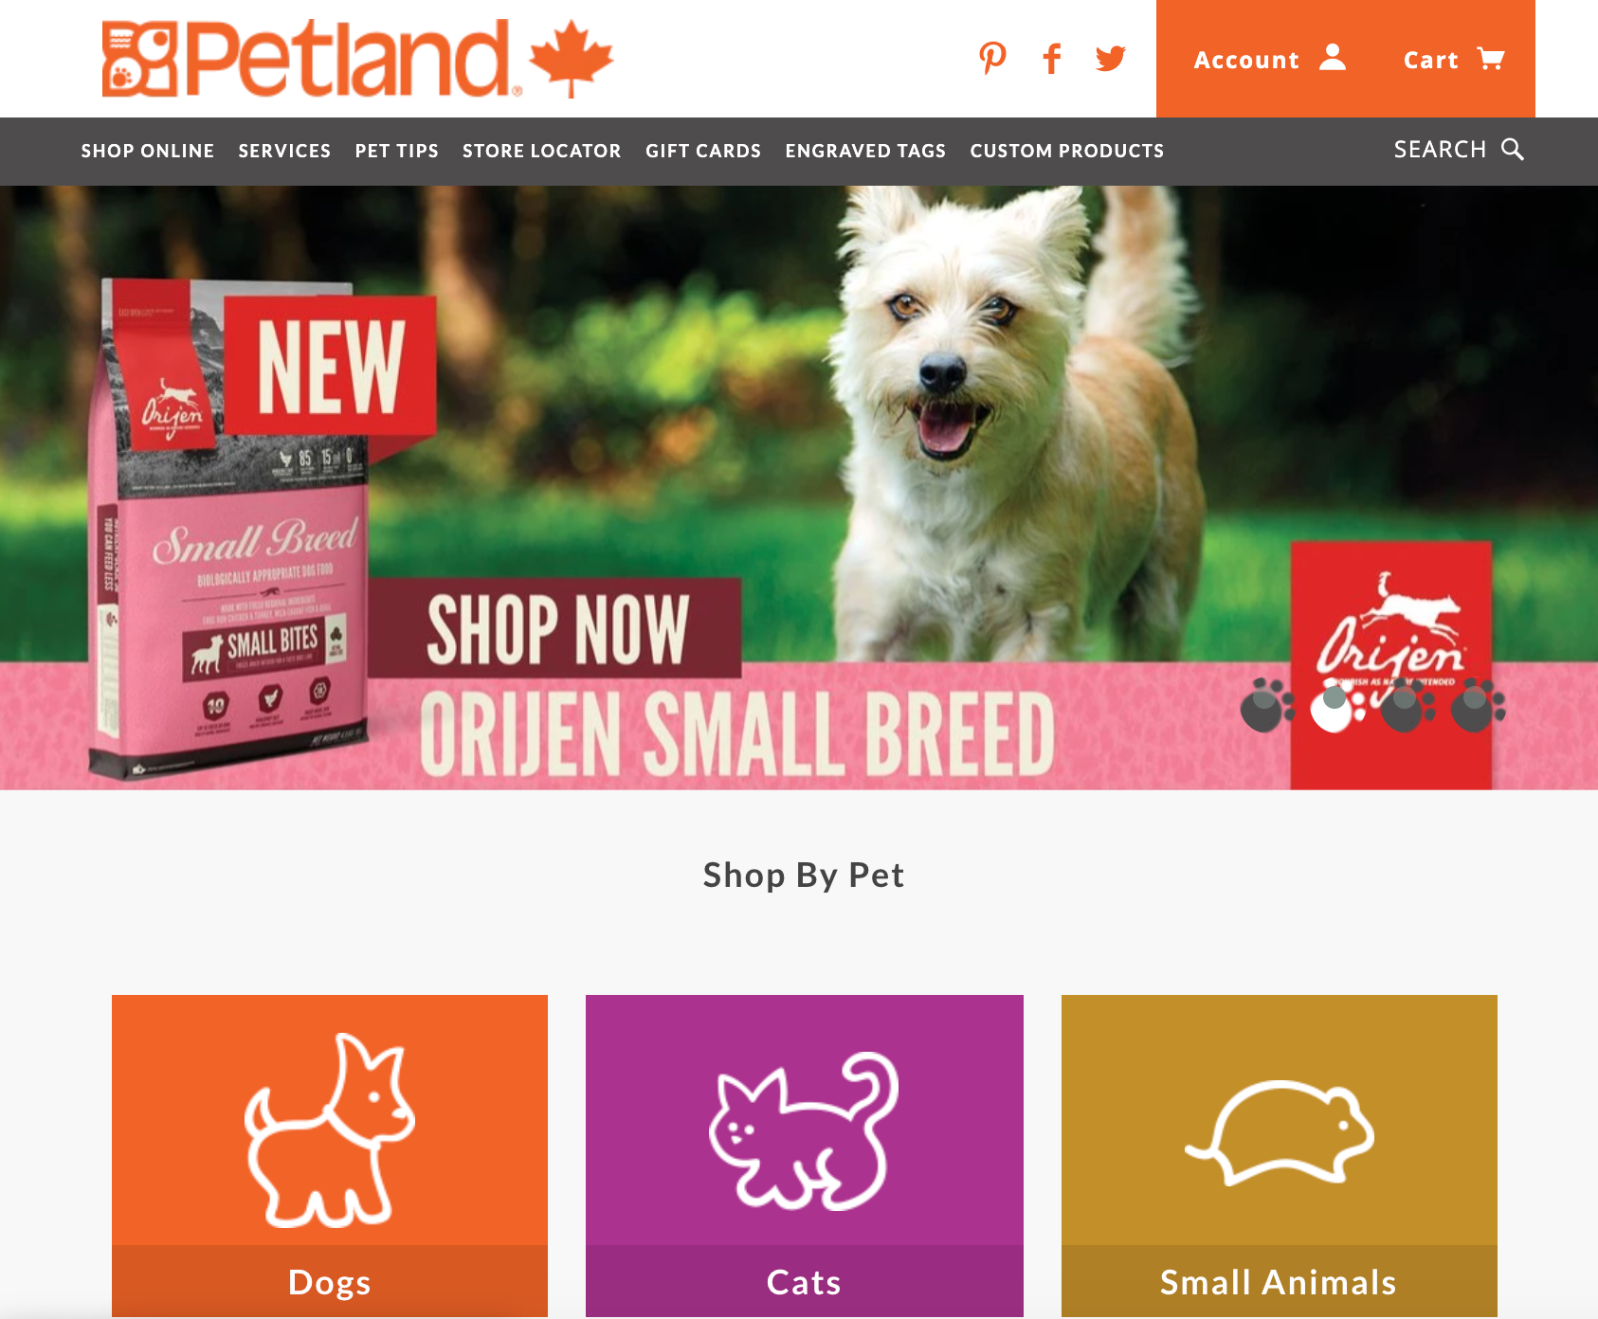

Slide 7
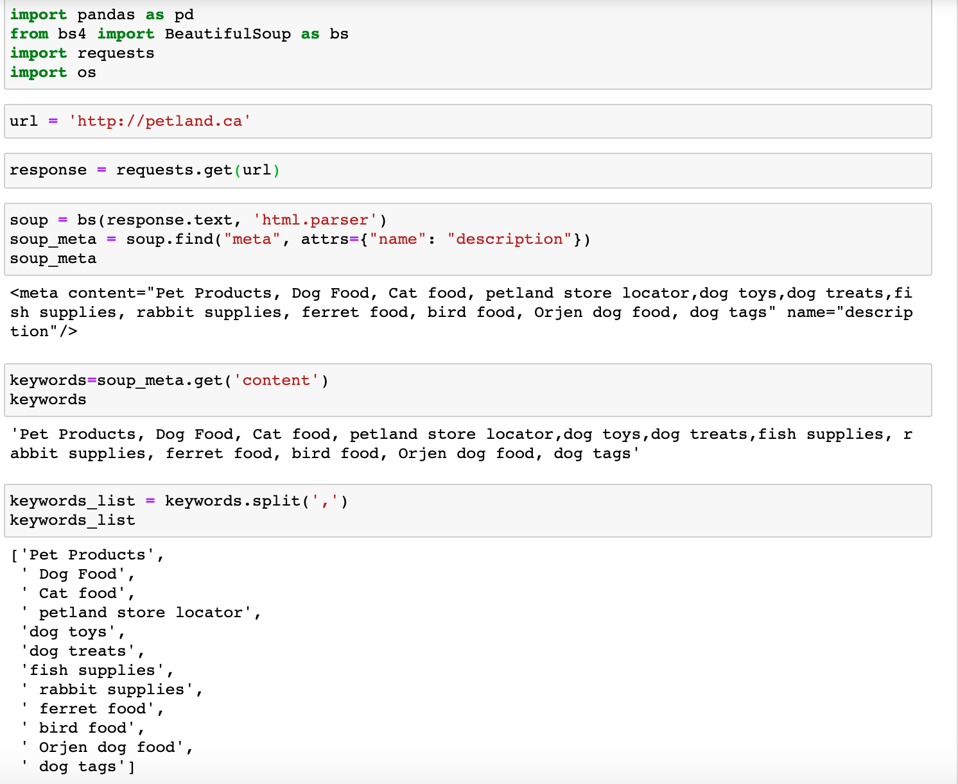

Slide 8
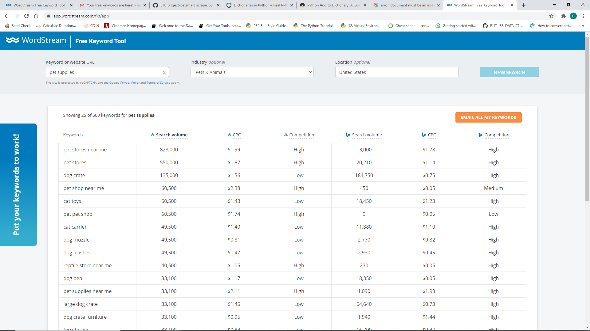

Slide 9
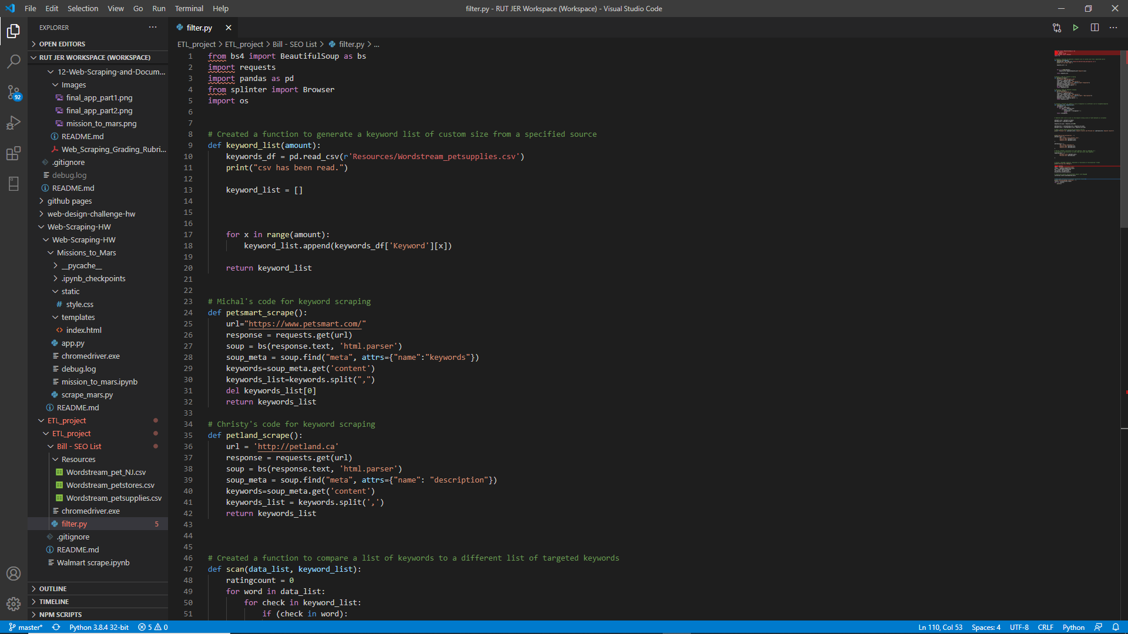

Slide 10
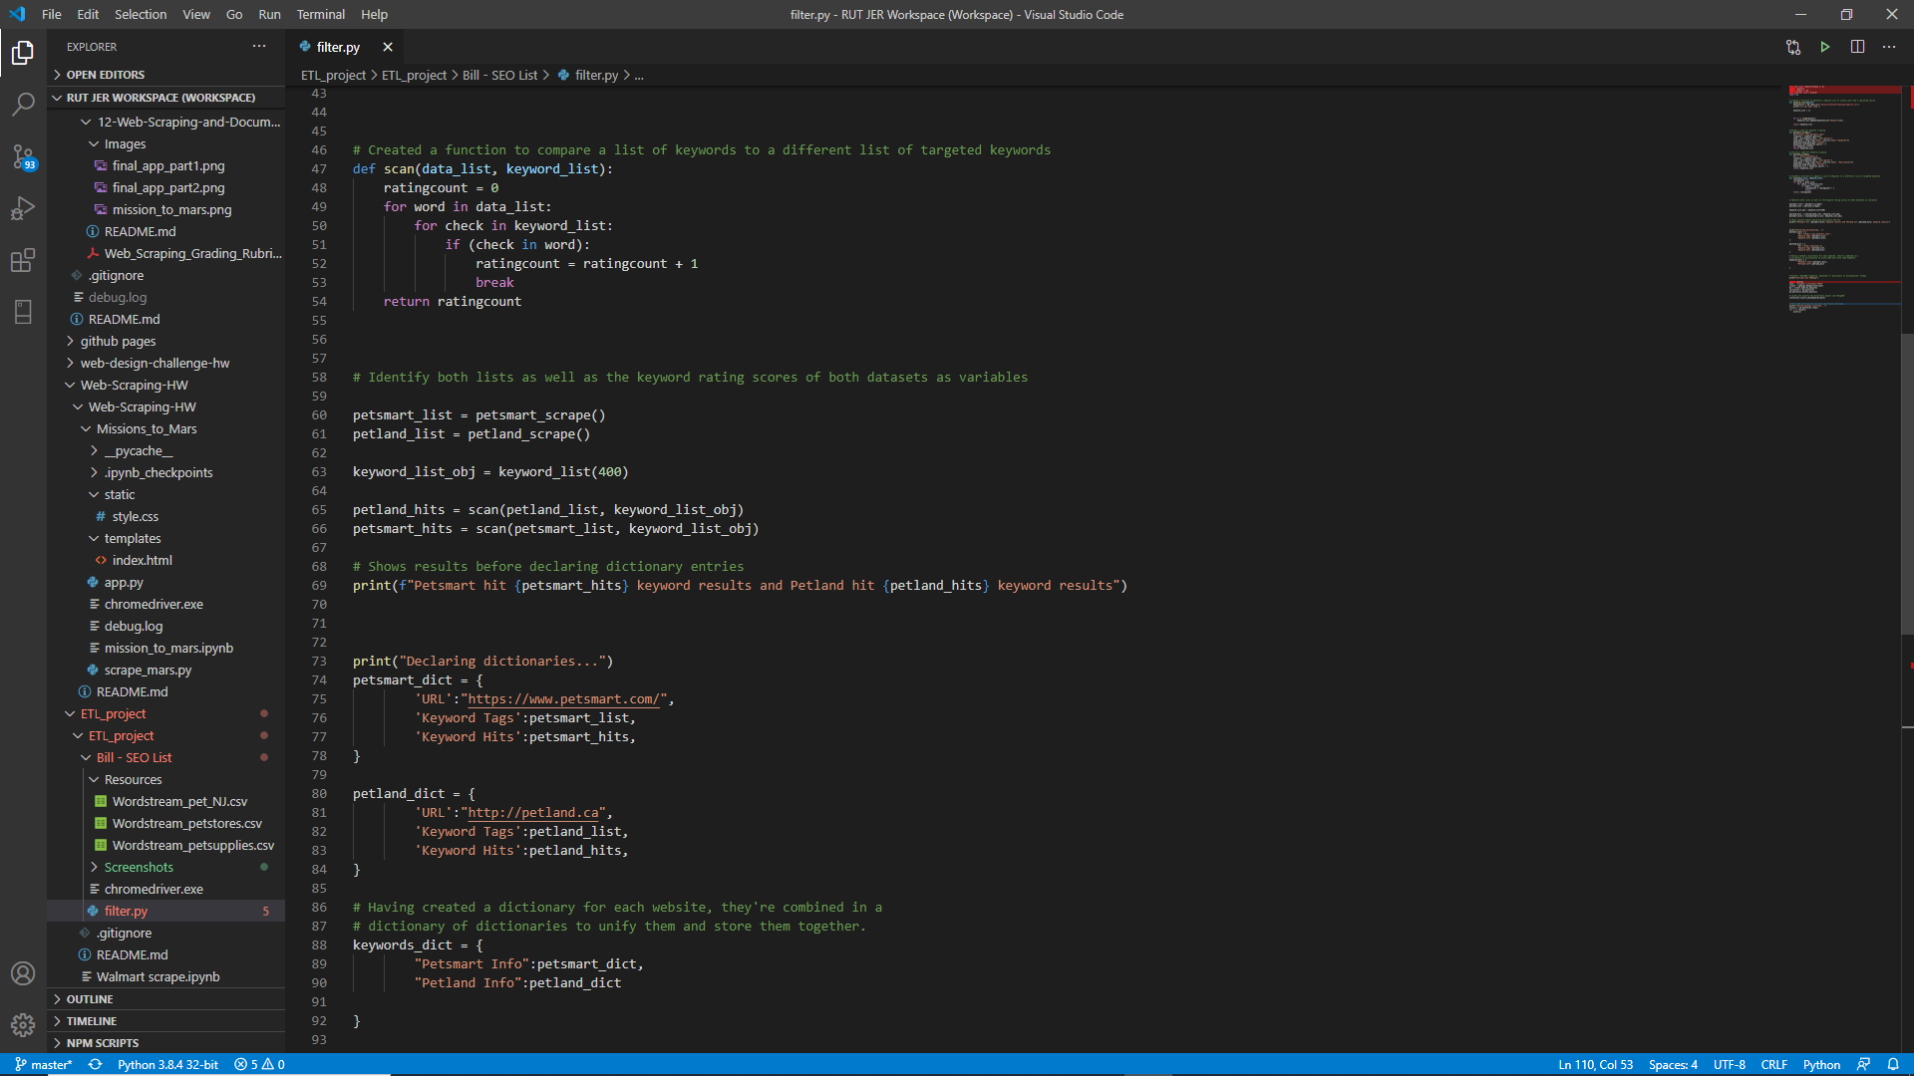

Slide 11
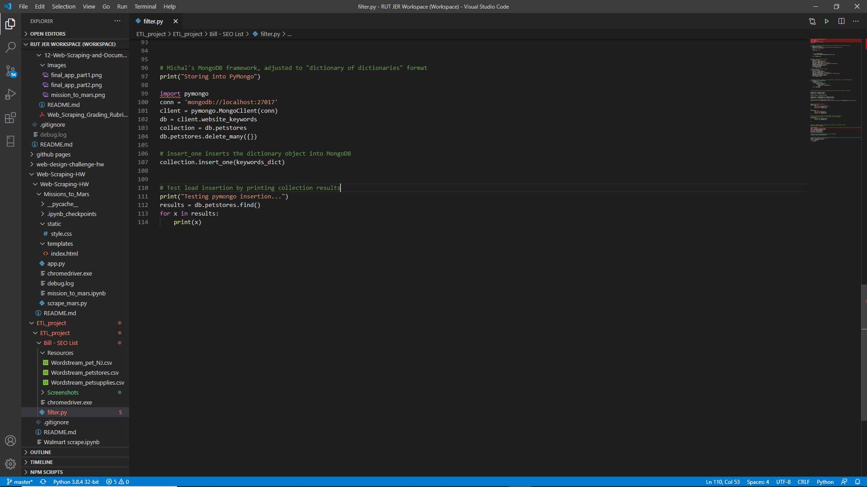

Slide 12

Thanks for listening!
(Now I need a nap.)

